Slide 1
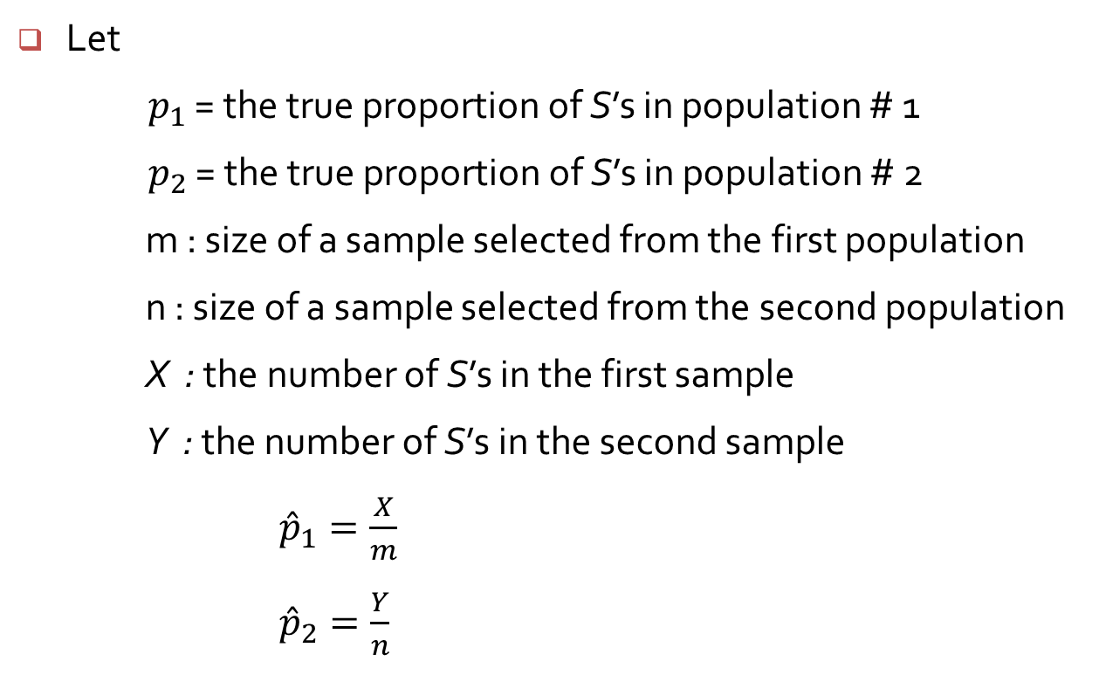
Inference Concerning a Difference Between Population Proportions
Let
$p_{1}$ = the true proportion of S’s in population # 1
$p_{2}$ = the true proportion of S’s in population # 2
m : size of a sample selected from the first population
n : size of a sample selected from the second population
X : the number of S’s in the first sample
Y : the number of S’s in the second sample
${\hat{p}}_{1}=\frac{X}{m}$
${\hat{p}}_{2}=\frac{Y}{n}$
X
m
Y
n

Slide 2
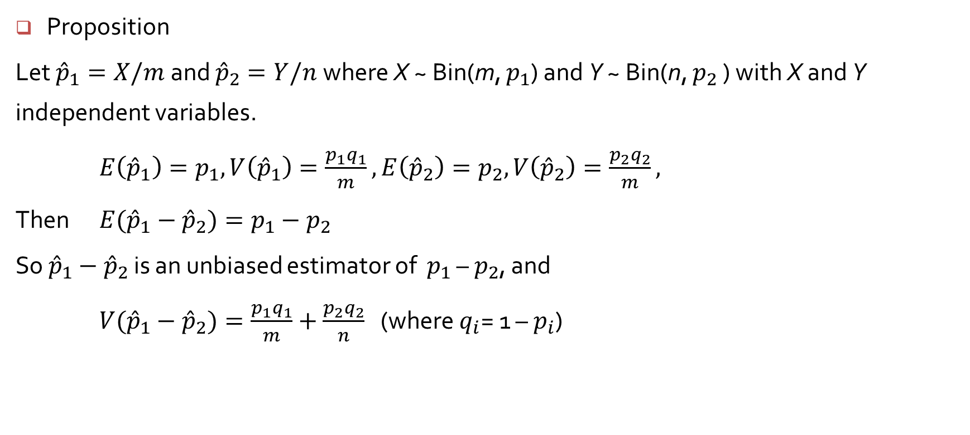
Inference Concerning a Difference Between Population Proportions
Proposition
Let ${\hat{p}}_{1}=X/m$and ${\hat{p}}_{2}=Y/n$where X ~ Bin(m, $p_{1}$) and Y ~ Bin(n, $p_{2}$ ) with X and Y independent variables.
$E\left({\hat{p}}_{1}\right)=p_{1}, V\left({\hat{p}}_{1}\right)=\frac{p_{1}q_{1}}{m}, E\left({\hat{p}}_{2}\right)=p_{2}, V\left({\hat{p}}_{2}\right)=\frac{p_{2}q_{2}}{m},$
Then $E({\hat{p}}_{1}−{\hat{p}}_{2})=p_{1}−p_{2}$
So ${\hat{p}}_{1}−{\hat{p}}_{2}$ is an unbiased estimator of $p_{1}$ – $p_{2}$, and
$V({\hat{p}}_{1}−{\hat{p}}_{2})=\frac{p_{1}q_{1}}{m}+\frac{p_{2}q_{2}}{n}$ (where $q_{i}$= 1 – $p_{i}$)

Slide 3
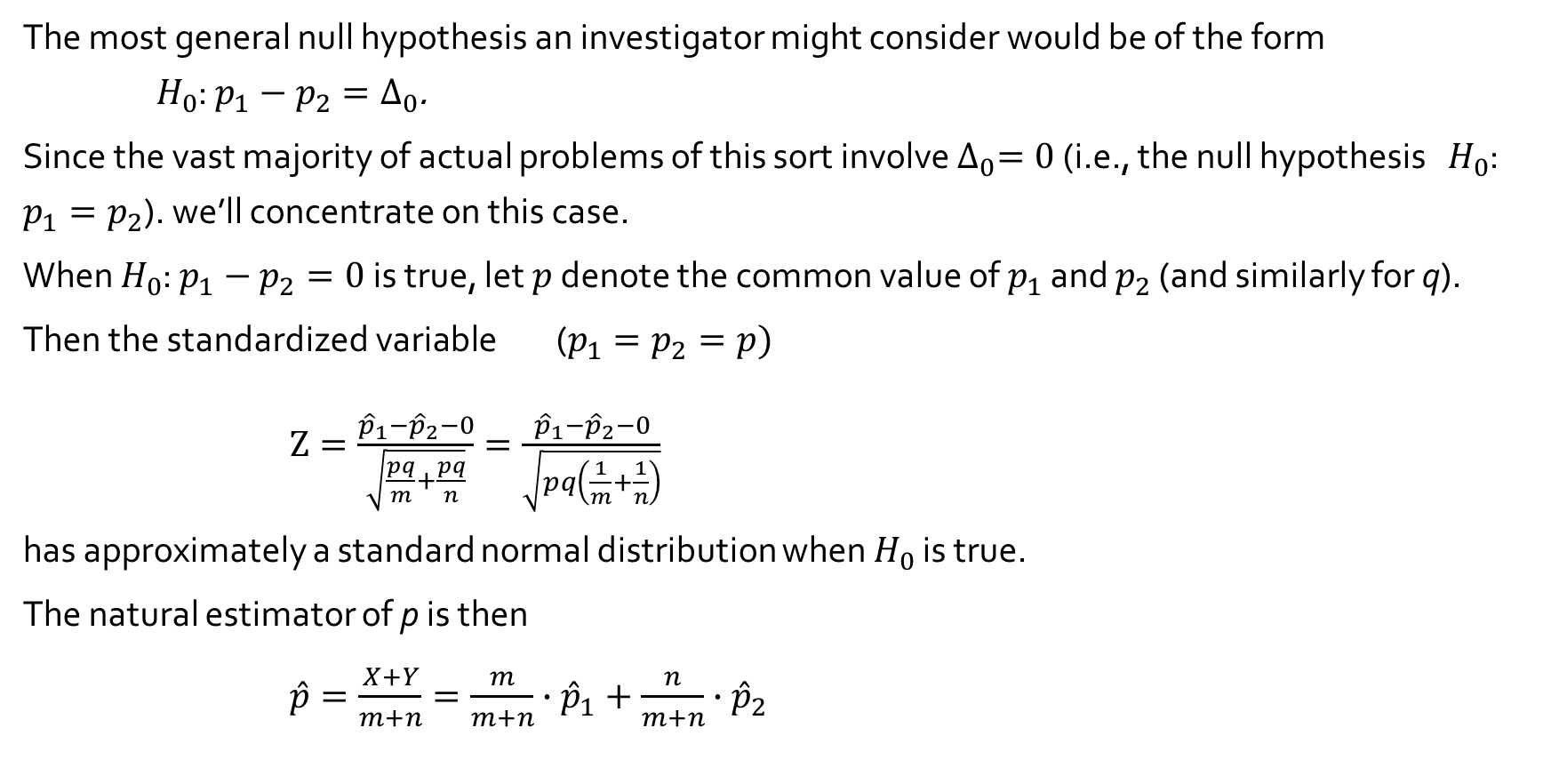
A Large-Sample Test Procedures
The most general null hypothesis an investigator might consider would be of the form $H_{0}$: $p_{1}−p_{2}=∆_{0}$.
Since the vast majority of actual problems of this sort involve $∆_{0}=0$ (i.e., the null hypothesis $H_{0}$: $p_{1}=p_{2}$). we’ll concentrate on this case.
When $H_{0}$: $p_{1}−p_{2}=0$is true, let $p$ denote the common value of $p_{1}$ and $p_{2}$ (and similarly for q).
Then the standardized variable ($p_{1}=p_{2}=p)$
$Z=\frac{{\hat{p}}_{1}−{\hat{p}}_{2}−0}{\sqrt{\frac{pq}{m}+\frac{pq}{n}}}=\frac{{\hat{p}}_{1}−{\hat{p}}_{2}−0}{\sqrt{pq\left(\frac{1}{m}+\frac{1}{n}\right)}}$
has approximately a standard normal distribution when $H_{0}$ is true.
The natural estimator of p is then
$\hat{p}=\frac{X+Y}{m+n}=\frac{m}{m+n}∙{\hat{p}}_{1}+\frac{n}{m+n}∙{\hat{p}}_{2}$

Slide 4
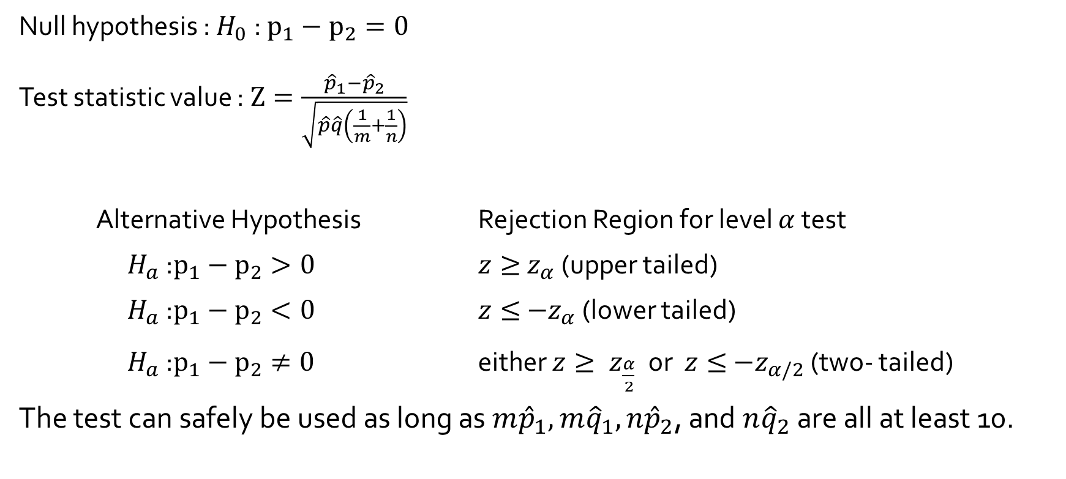
A Large-Sample Test Procedures
Null hypothesis : $H_{0}$ : $p_{1}−p_{2}=0$
Test statistic value : $Z=\frac{{\hat{p}}_{1}−{\hat{p}}_{2}}{\sqrt{\hat{p}\hat{q}\left(\frac{1}{m}+\frac{1}{n}\right)}}$
Alternative Hypothesis Rejection Region for level $α$ test
$H_{a}$ :$p_{1}−p_{2}>0$ $z≥{ z}_{α}$ (upper tailed)
$H_{a}$ :$p_{1}−p_{2}<0$ $z≤{ −z}_{α}$ (lower tailed)
$H_{a}$ :$p_{1}−p_{2}≠0$ either $z≥{ z}_{\frac{α}{2}} \text{or}$ $z≤{ −z}_{α/2}$ (two- tailed)
The test can safely be used as long as ${m\hat{p}}_{1}, {m\hat{q}}_{1}, {n\hat{p}}_{2}$, and ${n\hat{q}}_{2}$ are all at least 10.

Slide 5
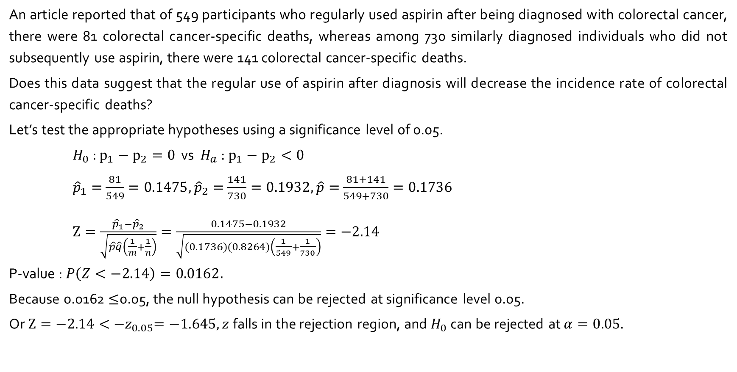
Example 9.11
An article reported that of 549 participants who regularly used aspirin after being diagnosed with colorectal cancer, there were 81 colorectal cancer-specific deaths, whereas among 730 similarly diagnosed individuals who did not subsequently use aspirin, there were 141 colorectal cancer-specific deaths.
Does this data suggest that the regular use of aspirin after diagnosis will decrease the incidence rate of colorectal cancer-specific deaths?
Let’s test the appropriate hypotheses using a significance level of 0.05.
$H_{0}$ : $p_{1}−p_{2}=0$ vs $H_{a}$ : $p_{1}−p_{2}<0$
${\hat{p}}_{1}=$ $\frac{81}{549}=0.1475, {\hat{p}}_{2}=$ $\frac{141}{730}=0.1932,\hat{p}=$ $\frac{81+141}{549+730}=0.1736$
$Z=\frac{{\hat{p}}_{1}−{\hat{p}}_{2}}{\sqrt{\hat{p}\hat{q}\left(\frac{1}{m}+\frac{1}{n}\right)}}=\frac{0.1475−0.1932}{\sqrt{(0.1736)(0.8264)\left(\frac{1}{549}+\frac{1}{730}\right)}}=−2.14$
P-value : $P\left(Z<−2.14\right)=0.0162.$
Because 0.0162 $≤$0.05, the null hypothesis can be rejected at significance level 0.05.
Or $Z=−2.14<{ −z}_{0.05}=−1.645, z$falls in the rejection region, and $H_{0}$ can be rejected at $α=0.05.$

Slide 6
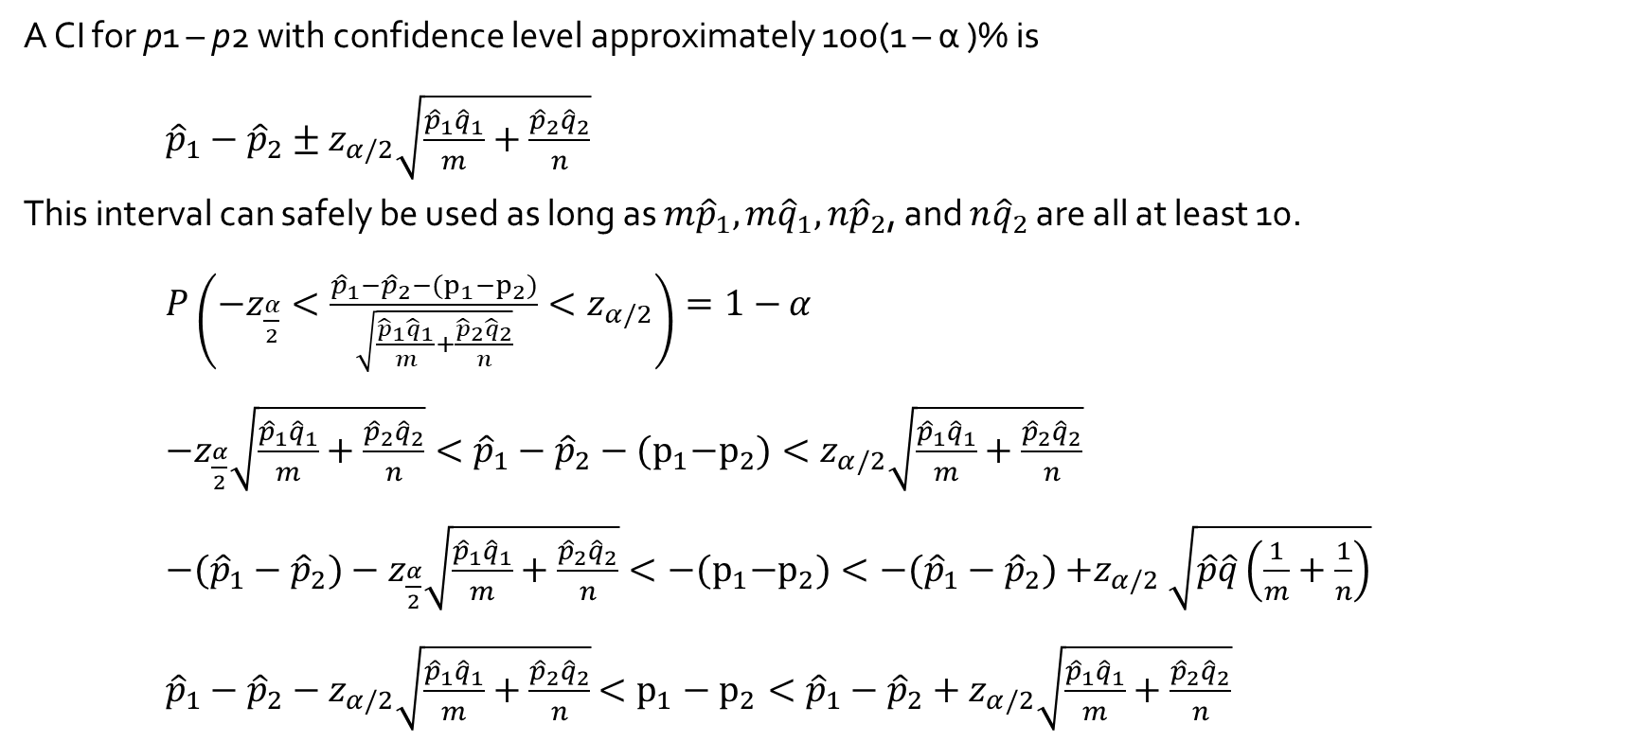
A Large-Sample Confidence Interval
A CI for p1 – p2 with confidence level approximately 100(1 – α )% is
${\hat{p}}_{1}−{\hat{p}}_{2}±z_{α/2}\sqrt{\frac{{\hat{p}}_{1}{\hat{q}}_{1}}{m}+\frac{{\hat{p}}_{2}{\hat{q}}_{2}}{n}}$
This interval can safely be used as long as ${m\hat{p}}_{1}, {m\hat{q}}_{1}, {n\hat{p}}_{2}$, and ${n\hat{q}}_{2}$ are all at least 10.
$P\left(−z_{\frac{α}{2}}<\frac{{\hat{p}}_{1}−{\hat{p}}_{2}−(p_{1}−p_{2})}{\sqrt{\frac{{\hat{p}}_{1}{\hat{q}}_{1}}{m}+\frac{{\hat{p}}_{2}{\hat{q}}_{2}}{n}}}<z_{α/2}\right)=1−$ $α$
$−z_{\frac{α}{2}}{\sqrt{\frac{{\hat{p}}_{1}{\hat{q}}_{1}}{m}+\frac{{\hat{p}}_{2}{\hat{q}}_{2}}{n}}<\hat{p}}_{1}−{\hat{p}}_{2}−{(p}_{1}−p_{2})<z_{α/2}\sqrt{\frac{{\hat{p}}_{1}{\hat{q}}_{1}}{m}+\frac{{\hat{p}}_{2}{\hat{q}}_{2}}{n}}$
$−({\hat{p}}_{1}−{\hat{p}}_{2})−z_{\frac{α}{2}}\sqrt{\frac{{\hat{p}}_{1}{\hat{q}}_{1}}{m}+\frac{{\hat{p}}_{2}{\hat{q}}_{2}}{n}}<−{(p}_{1}−p_{2})<−({\hat{p}}_{1}−{\hat{p}}_{2}){+z}_{α/2}\sqrt{\hat{p}\hat{q}\left(\frac{1}{m}+\frac{1}{n}\right)}$
${\hat{p}}_{1}−{\hat{p}}_{2}−z_{α/2}\sqrt{\frac{{\hat{p}}_{1}{\hat{q}}_{1}}{m}+\frac{{\hat{p}}_{2}{\hat{q}}_{2}}{n}}$ $<p_{1}−p_{2}<{\hat{p}}_{1}−{\hat{p}}_{2}+z_{α/2}\sqrt{\frac{{\hat{p}}_{1}{\hat{q}}_{1}}{m}+\frac{{\hat{p}}_{2}{\hat{q}}_{2}}{n}}$

Slide 7
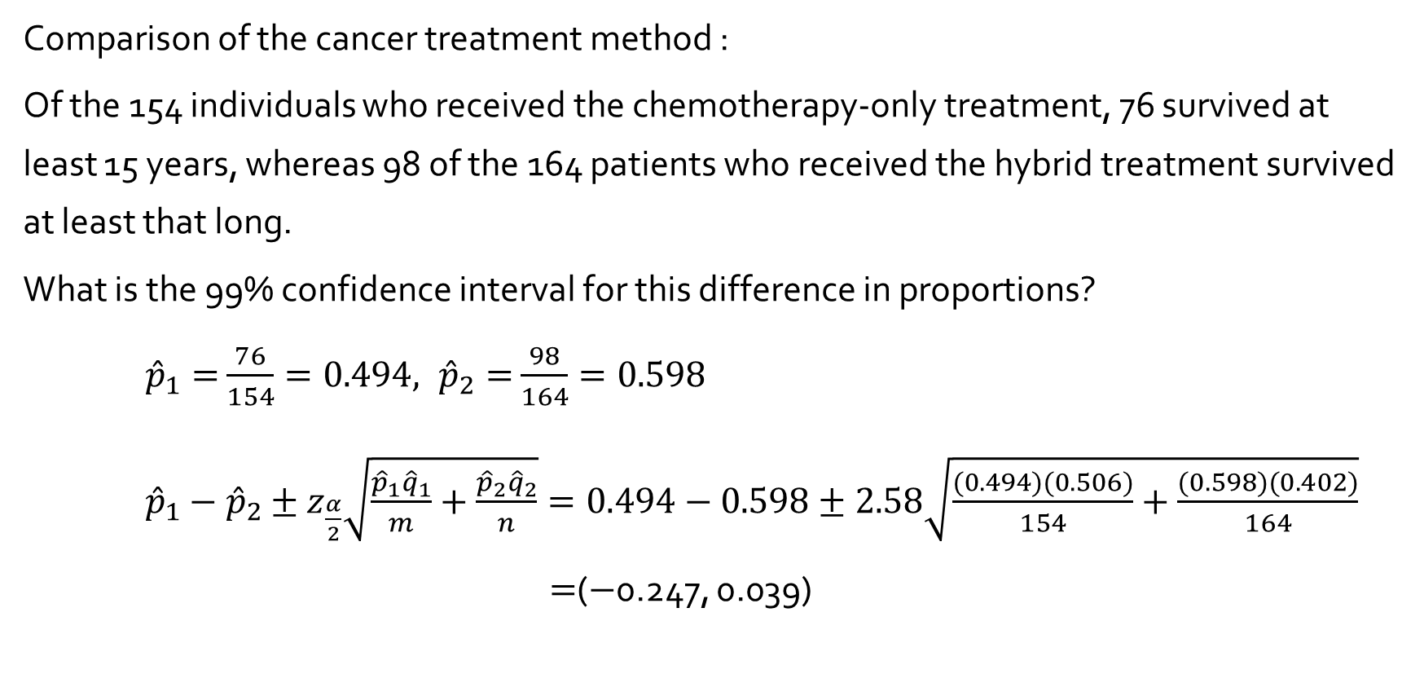
Example 9.12
Comparison of the cancer treatment method :
Of the 154 individuals who received the chemotherapy-only treatment, 76 survived at least 15 years, whereas 98 of the 164 patients who received the hybrid treatment survived at least that long.
What is the 99% confidence interval for this difference in proportions?
${\hat{p}}_{1}=$ $\frac{76}{154}=0.494, {\hat{p}}_{2}=$ $\frac{98}{164}=0.598$
${\hat{p}}_{1}−{\hat{p}}_{2}±z_{\frac{α}{2}}\sqrt{\frac{{\hat{p}}_{1}{\hat{q}}_{1}}{m}+\frac{{\hat{p}}_{2}{\hat{q}}_{2}}{n}}=0.494−0.598±2.58\sqrt{\frac{(0.494)(0.506)}{154}+\frac{(0.598)(0.402)}{164}}$
$=$($−$0.247, 0.039)

